Slide 1


EduBridge
From Generic Training to Classroom Ready Learning

Slide 2
JuniorCoders
Parth Petkar
parth.petkar2020@gmail.com
9175925435
Jayada Jodh
jodhjayada007@gmail.com
9371084133
Siddhesh Joshi
siddheshjoshi2512@gmail.com
7058763553
Varad Kodgirwar
varadkod2023@gmail.com
8956160956

Slide 3


Theme
“Lack of need-based personalized designing in Teacher Professional Development”
1
The reason to select the Smart Adaptive Teacher Training Platform theme is supported by the urgent institutional need to bridge the gap between National Education Policy (NEP) 2020 mandates and the failing "one-size-fits-all" reality on the ground.
2
The selection of this theme is driven by a critical need to modernize India's educational infrastructure, which currently struggles with a massive "learning crisis" and institutional rigidity.

Slide 4
Our Solutions
EduBridge is a smart adaptive teacher training platform to bridge the gap between policy and practice, the solution leverages GenAI and data analytics to create a fast, flexible learning hub.
Real-Time Feedback and Analysis: the platform uses a web interface where teachers can report classroom issues. The AI Analyzer then groups it based on the three clusters.
GenAI-Powered Adaptive Training: AI takes the base training module and uses GenAI to automatically customize it by: • Translating content into local dialects.
• Contextualizing examples to match local culture.
• Adapting activities for schools with poor infrastructure or lack of materials.
3.Micro-Learning Modules: The system replaces long, outdated workshops with short, focused summary. The teachers only receive the specific training they need at that exact moment.
4.Dashboards DIET: Use a centralized dashboard to see a heatmap of cluster-wise needs. This allows them to generate and deploy relevant training modules instantly.

Slide 5
TechStack
Feature | Technology
Front-End | HTML,CSS,Javascrit,React
Back-End | Django & DRF,Python,NLP
Database | PostgreSQL
API | OpenAI/Gemini AI

Slide 6

Benefits
The solution is designed for rapid deployment by leveraging established technologies and policy frameworks:
Tech Stack: The platform utilizes a standard, scalable stack (React, Django, PostgreSQL) and connects to powerful, ready-to-use GenAI APIs (OpenAI/Gemini) for content customization
The AI Need Analyzer automatically groups thousands of teachers into clusters, manually impossible for small DIET staffs
Implementation is eased by direct alignment with NEP 2020 Para 5.15.
The platform directly addresses the "one-size-fits-all" crisis through Smart Customization.

Slide 7
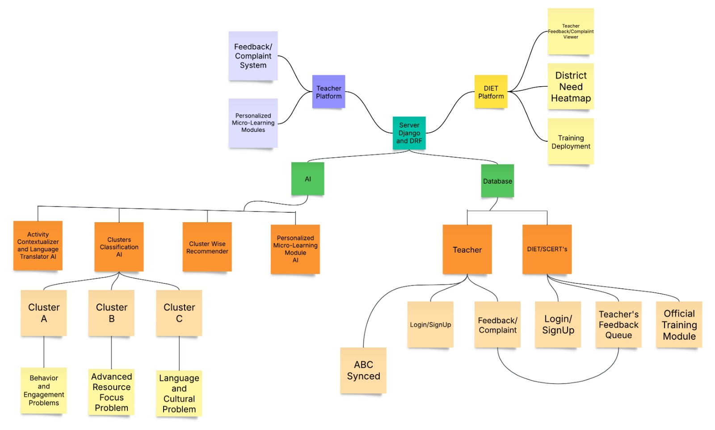
Architecture Diagram

Slide 8
Thank You!

